Slide 1
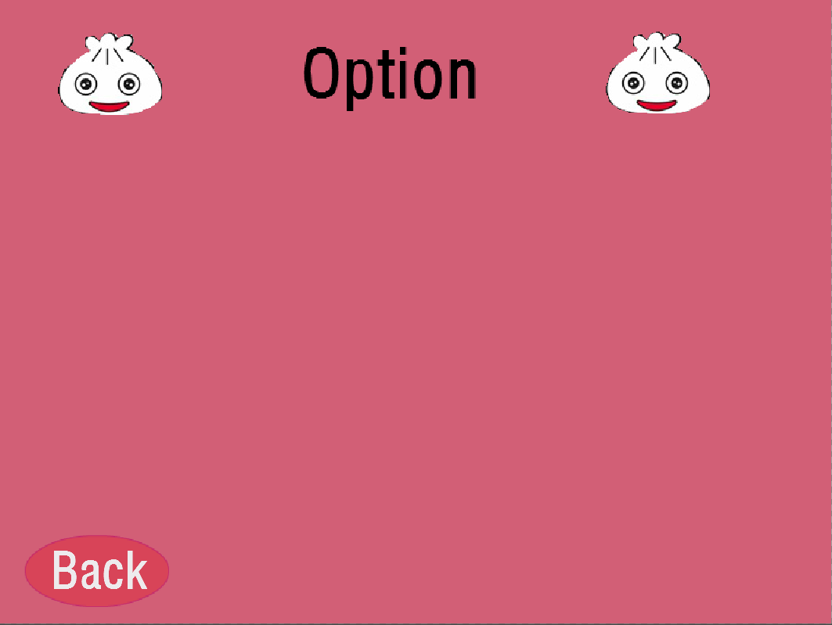


effect sound
background sound

Slide 2
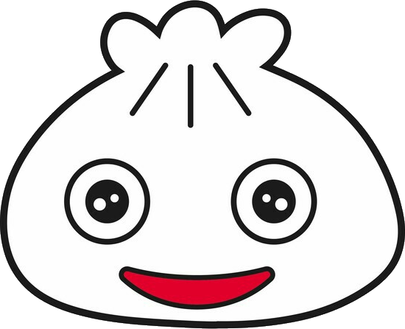




Character
choose
Back
Start

